Slide 1
HR and Safety –
They are NOT the Same Thing
Lake County Safety Council
January 13, 2017
Rose Ann Kay
SPHR, GPHR, SHRM-SCP

Slide 2
Legal Disclaimer
Rose Ann Kay is not an attorney and does not provide legal advice. Statements and opinions are those of a human resource practitioner and are not intended as legal advice. Participants are strongly encouraged to consult legal counsel as necessary.

Slide 3
Topics
Role of Human Resources
Why HR ≠ Safety
How HR & Safety Can Partner Together

Slide 4

My Safety Experiences:

Slide 5

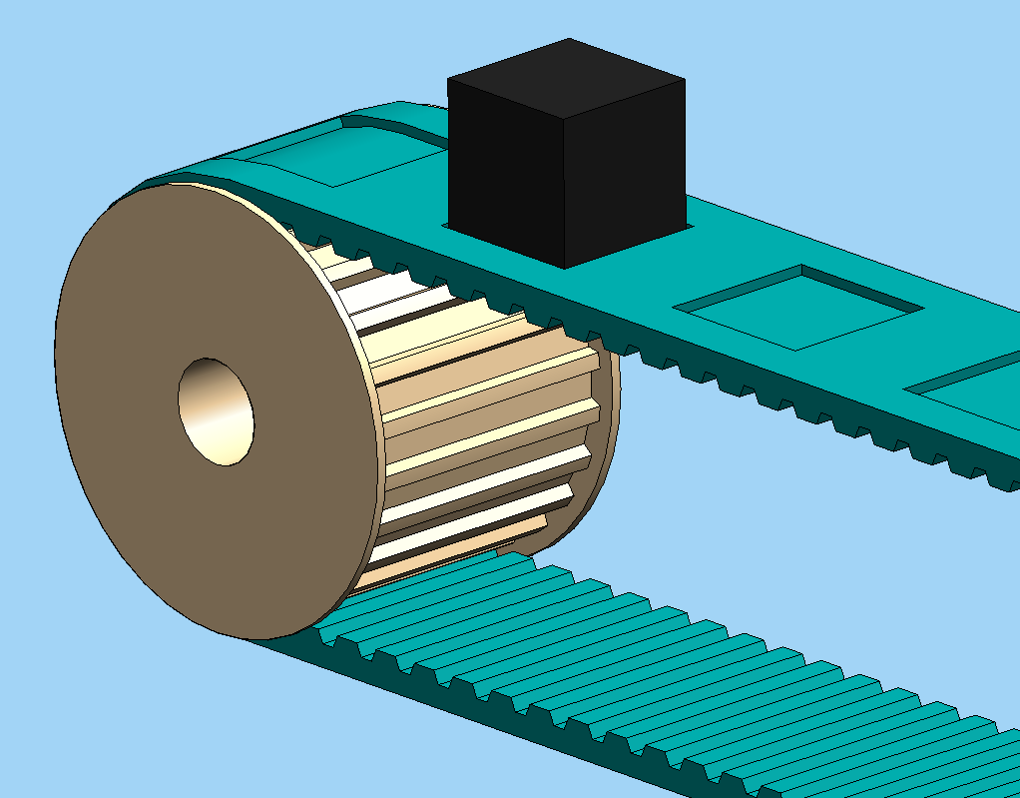
My Safety Experiences:

Slide 6





Role of Human Resources
In the Beginning…
HIRING

Slide 7





…HR can do it!
HIRING

Slide 8

Human Resources Today
+Business Partner
+Strategy
+Culture
+Change Agent
Notes:
Support Supv Ees

Slide 9





HR Certifications
Notes:
CP “Understand strategic relationship between HR and core functions”
For HR professionals who are primarily engaged in operational roles
SCP “Align HR and business strategy, goals, objectives” senior level operating at a strategic role
For HR professionals at a senior level who operate primarily in a strategic role

Slide 10
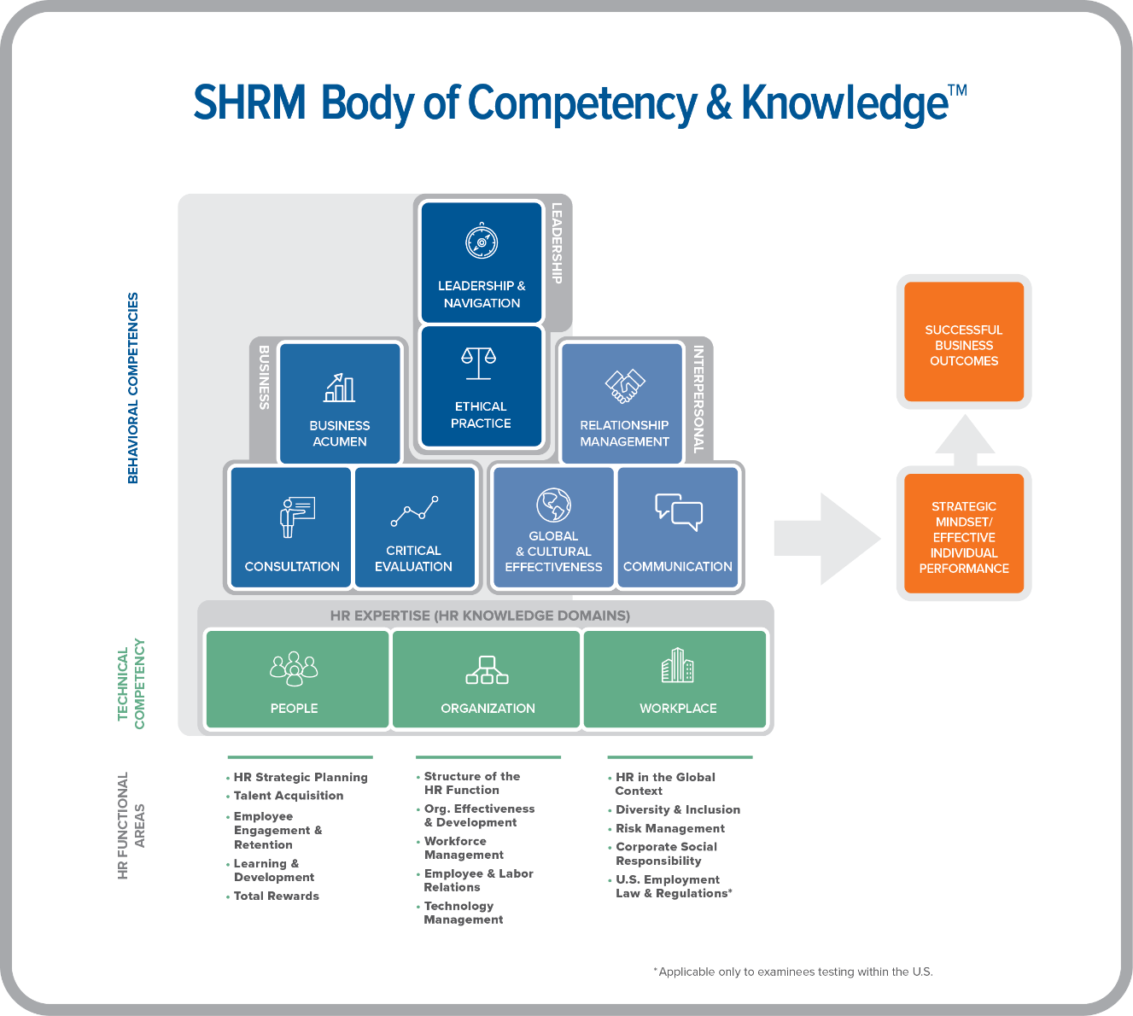
Notes:
Here we can see how the 9 Competencies
--including HR Expertise tie together

Slide 11

HR Expertise Functional Areas
HR Strategic Planning
Talent Acquisition
Employee Engagement and Retention
Learning and Development
Total Rewards
Structure of the HR Function
Organizational Effective-ness and Development
Workforce Management
Employee and Labor Relations
Technology Management
HR in the Global Context
Diversity and Inclusion
Risk Management
Corporate Social Responsibility
U.S. Employment Law and Regulations

Slide 12
Why HR and Safety are NOT the Same Thing
Both areas are highly complex
  Requiring specialized KSACs
  Requiring time and attention to detail
“Bestowing” additional duties will have a diminishing return on the effectiveness and efficiency of both areas
  HR⇒Safety
  Safety⇒HR
“Doing more with less” without requisite training, development, resources, and tools will not bode well long-term

Slide 13
But…HR & Safety
Must Effectively Partner
SAFETY
Technical Expertise
EHS
Investigations
HR
Compliance
Training
Rewards
Corrective Action
SAFE
&
HEALTHY
EMPLOYEES
Organizational Success

Slide 14


Partner: Compliance
Title VII Civil Rights Act
ADA
FMLA
WC
ADEA
DOL
EEOC
BFOQ
HIPAA
EAP
OSHA
HAZCOMM/MSDS
Lockout/Tagout
BBP
PPE
Means of Egress
Hearing Conservation
EPA

Slide 15

Partner: Hiring & Orientation
Match candidates to the organization’s safety culture
Drug Screens
Post-Offer, Pre-Start Physical Exams
Hep B upon hire
Work with Safety and First Line Supervisors on new employee orientation

Slide 16

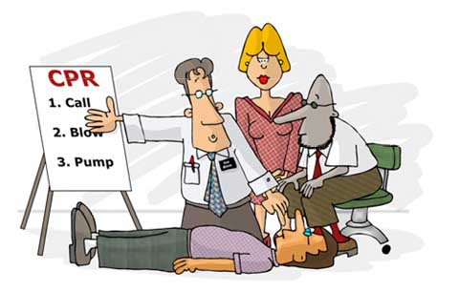
Partner: Training
Develop Training
Schedule
Training Due
Documentation
1st Responder Training

Slide 17



Partner: Rewards & Recognition
Reinforce Safety Culture
Safety Incentive Programs
Manage WC, STD, LTD
Safety Recognition Programs
EAP, Wellness Programs

Slide 18
Partnering:
The Bermuda Triangle
transitional work
WC
ADA
FMLA
return-to-work
leaves of absence

Slide 19
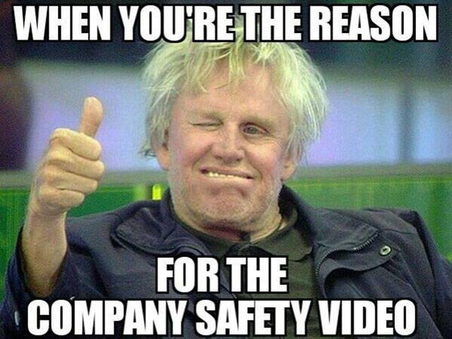

Partner: Employee Relations
Safety Committees
Partnering with Unions
Corrective Action

Slide 20


Partner: Tech & Data
HRIS (Human Resource Information System)
  Track Training
  WC/LOAs
  ADA Accommodations
  OSHA Log & Incidence Reports
  Safety Trends/Reporting

Slide 21

Partnering: OSHA Log
Recordable???

Slide 22

Partner: Risk Management
Crisis Management
  Emergency Preparedness
  Emergency Response
Business Continuity
Protect
  PEOPLE
    PROPERTY
      PROPRIETARY INFO

Slide 23

Partnering: Plan & Respond
TROs!!!

Slide 24


Partnering: Secure Facility
But We Have Cameras!

Slide 25


Partnering: Safety Incident

Slide 26


Partnering: Facilities

Slide 27


Resources
www.hrci.org
www.shrm.org
www.lgashrm.org

Slide 28

Questions & Answers!
Notes:
(SLIDE)

Slide 29
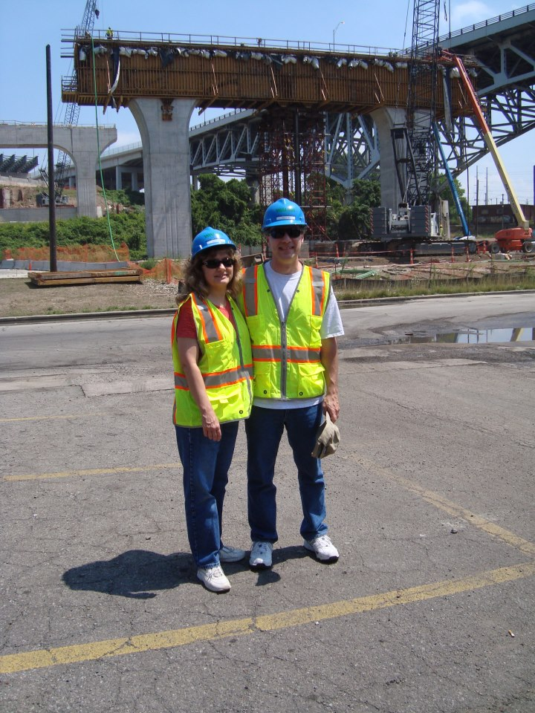

Rose Ann Kay
SPHR, GPHR, SHRM-SCP
Principal
Humanics, LLC
P.O. Box 837
Chardon OH 44024
440-285-2235
Rkay@HumanicsLLC.com
rose-ann-kay-sphr-gphr-shrm-scp-24200a3

